Slide 1
LAB 4 Queries on Multiple Relations
Dr. Sikha O K
Assistant Professor(Sr.Gr)
CSE Department
ASE-Coimbatore
Reference: Database System Concepts sixth edition, W3 Schools, Tutorial Point

Slide 2
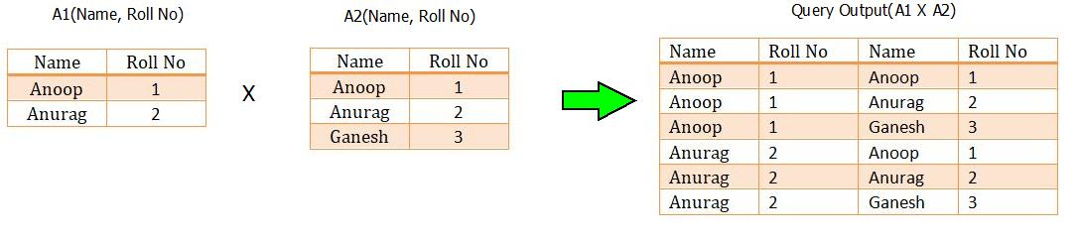
Cartesian Product
The CARTESIAN JOIN or CROSS JOIN returns the Cartesian product of the sets of records from two or more joined tables.
SELECT table1.column1, table2.column2... FROM table1, table2 [, table3 ]

Slide 3
CUSTOMER
ID | NAME | AMOUNT | DATE
1 | Ramesh | 3000 | 10/8/2009
1 | Ramesh | 1500 | 10/8/2009
1 | Ramesh | 1560 | 11/20/2009
1 | Ramesh | 2060 | 5/20/2008
2 | Khilan | 3000 | 10/8/2009
2 | Khilan | 1500 | 10/8/2009
2 | Khilan | 1560 | 11/20/2009
2 | Khilan | 2060 | 5/20/2008
3 | kaushik | 3000 | 10/8/2009
3 | kaushik | 1500 | 10/8/2009
3 | kaushik | 1560 | 11/20/2009
3 | kaushik | 2060 | 5/20/2008
4 | Chaitali | 3000 | 10/8/2009
4 | Chaitali | 1500 | 10/8/2009
4 | Chaitali | 1560 | 11/20/2009
4 | Chaitali | 2060 | 5/20/2008
5 | Hardik | 3000 | 10/8/2009
5 | Hardik | 1500 | 10/8/2009
5 | Hardik | 1560 | 11/20/2009
5 | Hardik | 2060 | 5/20/2008
6 | Komal | 3000 | 10/8/2009
6 | Komal | 1500 | 10/8/2009
6 | Komal | 1560 | 11/20/2009
6 | Komal | 2060 | 5/20/2008
7 | Muffy | 3000 | 10/8/2009
7 | Muffy | 1500 | 10/8/2009
7 | Muffy | 1560 | 11/20/2009
7 | Muffy | 2060 | 5/20/2008
ID | NAME | AGE | ADDRESS | SALARY
1 | Ramesh | 32 | Ahmedabad | 2000
2 | Khilan | 25 | Delhi | 1500
3 | kaushik | 23 | Kota | 2000
4 | Chaitali | 25 | Mumbai | 6500
5 | Hardik | 27 | Bhopal | 8500
6 | Komal | 22 | MP | 4500
7 | Muffy | 24 | Indore | 10000
SELECT ID, NAME, AMOUNT, DATE
FROM CUSTOMERS, ORDERS;
ORDER
OID | DATE | CUSTOMER_ID | AMOUNT
102 | 2009-10-08 00:00:00 | 3 | 3000
100 | 2009-10-08 00:00:00 | 3 | 1500
101 | 2009-11-20 00:00:00 | 2 | 1560
103 | 2008-05-20 00:00:00 | 4 | 2060
WHERE CUTOMER.ID= ORDER.CUSTOMER_ID

Slide 4
Natural Join
The SQL NATURAL JOIN is a type of EQUI JOIN and is structured in such a way that, columns with the same name of associated tables will appear once only.
The associated tables have one or more pairs of identically named columns.
The columns must be the same data type.
Don’t use ON clause in a natural join.
SELECT * FROM table1 NATURAL JOIN table2;

Slide 5
foods
COMPANY_ID | ITEM_ID | ITEM_NAME | ITEM_UNIT | COMPANY_NAME | COMPANY_CITY
16 | 1 | Chex Mix | Pcs | Akas Foods | Delhi
15 | 6 | Cheez-It | Pcs | Jack Hill Ltd | London
15 | 2 | BN Biscuit | Pcs | Jack Hill Ltd | London
17 | 3 | Mighty Munch | Pcs | Foodies. | London
15 | 4 | Pot Rice | Pcs | Jack Hill Ltd | London
18 | 5 | Jaffa Cakes | Pcs | Order All | Boston
ITEM_ID | ITEM_NAME | ITEM_UNIT | COMPANY_ID
1 | Chex Mix | Pcs | 16
6 | Cheez-It | Pcs | 15
2 | BN Biscuit | Pcs | 15
3 | Mighty Munch | Pcs | 17
4 | Pot Rice | Pcs | 15
5 | Jaffa Cakes | Pcs | 18
7 | Salt n Shake | Pcs
SELECT *
FROM foods
NATURAL JOIN company;
company
COMPANY_ID | COMPANY_NAME | COMPANY_CITY
18 | Order All | Boston
15 | Jack Hill Ltd | London
16 | Akas Foods | Delhi
17 | Foodies. | London
19 | sip-n-Bite. | New York

Slide 6
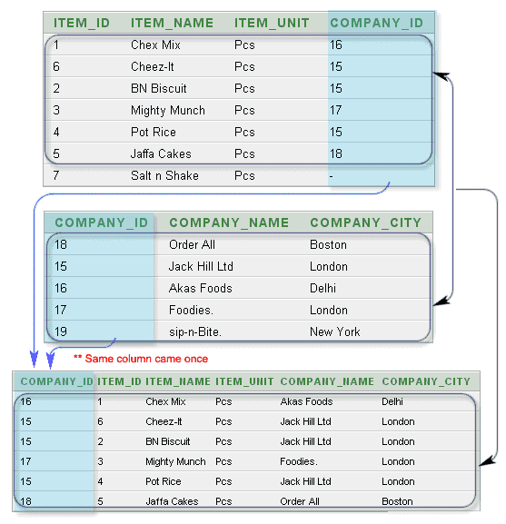

Slide 7
Aggregate Functions
These functions operate on the multiset of values of a column of a relation, and return a value
avg: average value min: minimum value max: maximum value sum: sum of values count: number of values

Slide 8
Aggregate Functions
Find the average salary of instructors in the Computer Science department
select avg (salary) from instructor where dept_name=‘CSE.’;
Find the number of tuples in the indtructor relation
select count (*) from course;
Display the count of instructors in each department
ID | NAME | AGE | DEPNAME | SALARY
E08 | RAJANI | 48 | PHY | 55000
E07 | PREMA | 45 | PHY | 60000
E02 | VISHAL | 29 | MECH | 45000
E03 | ANU | 30 | EEE | 35000
E05 | ARUN | 25 | EEE | 50000
E06 | AJITH | 32 | CSE | 38000
E01 | NITA | 23 | CSE | 40000
E04 | ABHISHEK | 35 | CSE | 50000
DEPT | DEPT_COUNT
PHY | 2
EEE | 2
CSE | 3
MECH | 1

Slide 9
Group By/Having
Display the count of instructors in each department
ID | NAME | AGE | DEPNAME | SALARY
E08 | RAJANI | 48 | PHY | 55000
E07 | PREMA | 45 | PHY | 60000
E02 | VISHAL | 29 | MECH | 45000
E03 | ANU | 30 | EEE | 35000
E05 | ARUN | 25 | EEE | 50000
E06 | AJITH | 32 | CSE | 38000
E01 | NITA | 23 | CSE | 40000
E04 | ABHISHEK | 35 | CSE | 50000
SELECT column_name(s) FROM table_name WHERE condition GROUP BY column_name(s)
Select depname as dept,count(*) as dept_count
from instructor
group by depname;
DEPT | DEPT_COUNT
PHY | 2
EEE | 2
CSE | 3
MECH | 1

Slide 10
Display the count of instructors in each department as dept_count and order the output as the ascending order of department name
ID | NAME | AGE | DEPNAME | SALARY
E08 | RAJANI | 48 | PHY | 55000
E07 | PREMA | 45 | PHY | 60000
E02 | VISHAL | 29 | MECH | 45000
E03 | ANU | 30 | EEE | 35000
E05 | ARUN | 25 | EEE | 50000
E06 | AJITH | 32 | CSE | 38000
E01 | NITA | 23 | CSE | 40000
E04 | ABHISHEK | 35 | CSE | 50000
DEPT | DEPT_COUNT
CSE | 3
EEE | 2
MECH | 1
PHY | 2
Select depname as dept,count(*) as dept_count
from instructor
group by depname
Order by depname ;

Slide 11
Display the count of instructors in each department as dept_count [only include departments with more than 1 instructors] and order the output as the ascending order of department name
ID | NAME | AGE | DEPNAME | SALARY
E08 | RAJANI | 48 | PHY | 55000
E07 | PREMA | 45 | PHY | 60000
E02 | VISHAL | 29 | MECH | 45000
E03 | ANU | 30 | EEE | 35000
E05 | ARUN | 25 | EEE | 50000
E06 | AJITH | 32 | CSE | 38000
E01 | NITA | 23 | CSE | 40000
E04 | ABHISHEK | 35 | CSE | 50000
DEPT | DEPT_COUNT
CSE | 3
EEE | 2
MECH | 1
PHY | 2
Select depname as dept,count(*) as dept_count
from instructor
group by depname
having dept_count >1
Order by depname ;

Slide 12
LAB 4 : SUBMISSION
Create a document:
Title: 19CSE202 LAB3: SQL CONSTRAINTS
For each question paste your query and the result.
Name of the document: rollno_lab4 [Eg: 10_lab4]
Upload the document as a PDF in to:
https://forms.office.com/Pages/ResponsePage.aspx?id=o835AF4H5USqC6ujrdZTny9-f2Cgnx1EoeSmVJuiV_pURFBNRVoyQ1JNQjJTT0pMQ1FSNjdCOFdZNy4u

Slide 13
THANK YOU

